Slide 1
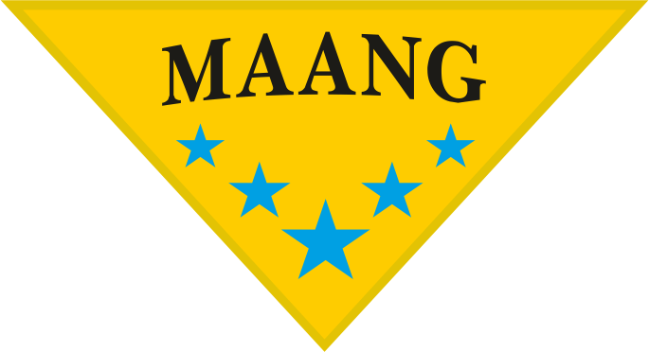

In the Name of God
صنایع رنگ مانگ
Refinish Automotive Coatings
پوششهای تعمیراتی خودرویی
Presented By: Dr Armin Hajibaba-Maang Company
ارائه شده: دکتر آرمین حاجی بابا- کارخانه رنگ مانگ

Slide 2
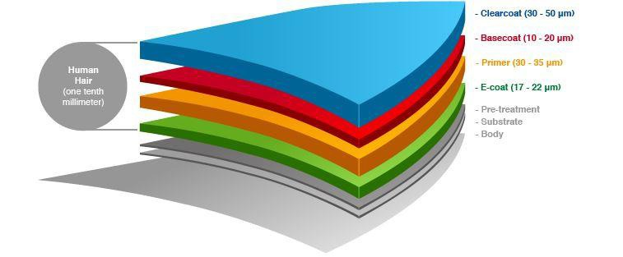
صنایع رنگ مانگ
Cathodic e-coating gives the car body a primer coat. It protects the car from corrosion , especially the cavities of the body that cannot be reached easily by spray application.
Primer: evens out any irregularities of the underlying layer. It can be sanded easily and provides a smooth surface.
Basecoat: gives the main color to the piece, therefore it plays a significant role in establishing the final visual impression.
Clear-coat: seals everything else and is applied last. It protects the car from external elements like snow, UV radiation, dirt, etc…
OEM
Automotive Coatings:
Refinish

Slide 3
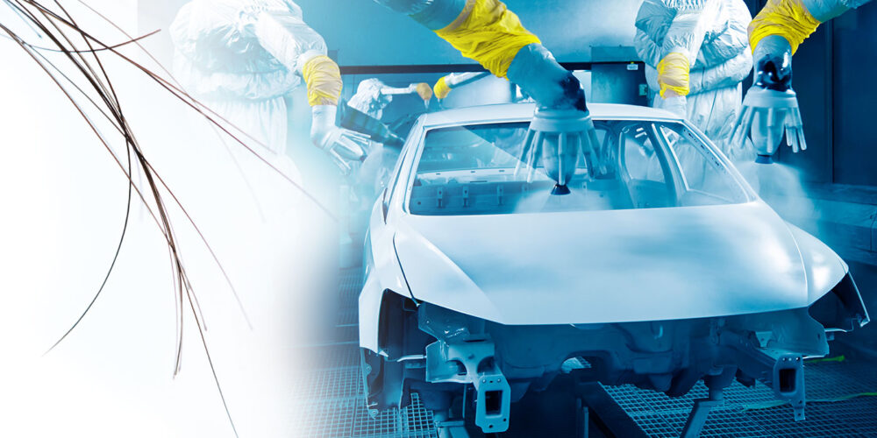
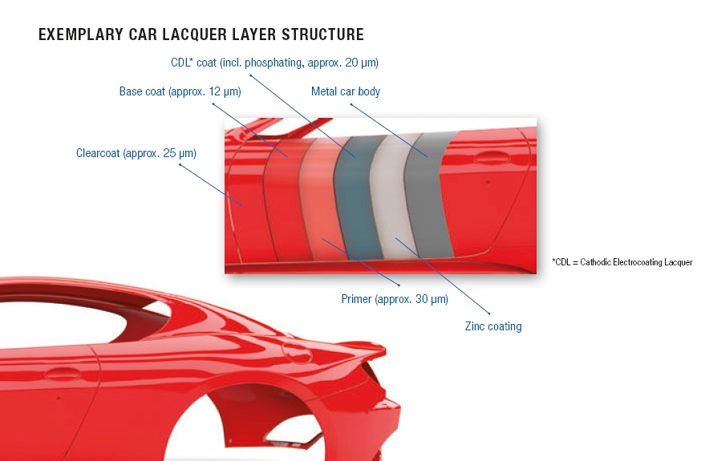
OEM Car Paint:
Car manufacturers use OEM (Original Equipment Manufacturer) paint in the factory. In highly controlled factory settings, with robotic precision, OEM automotive paint provides consistent color, durability, and finishing. In addition, it’s tested to withstand weather, heat, and wear and tear in the long term, providing peace of mind with warranty coverage.
صنایع رنگ مانگ

Slide 4
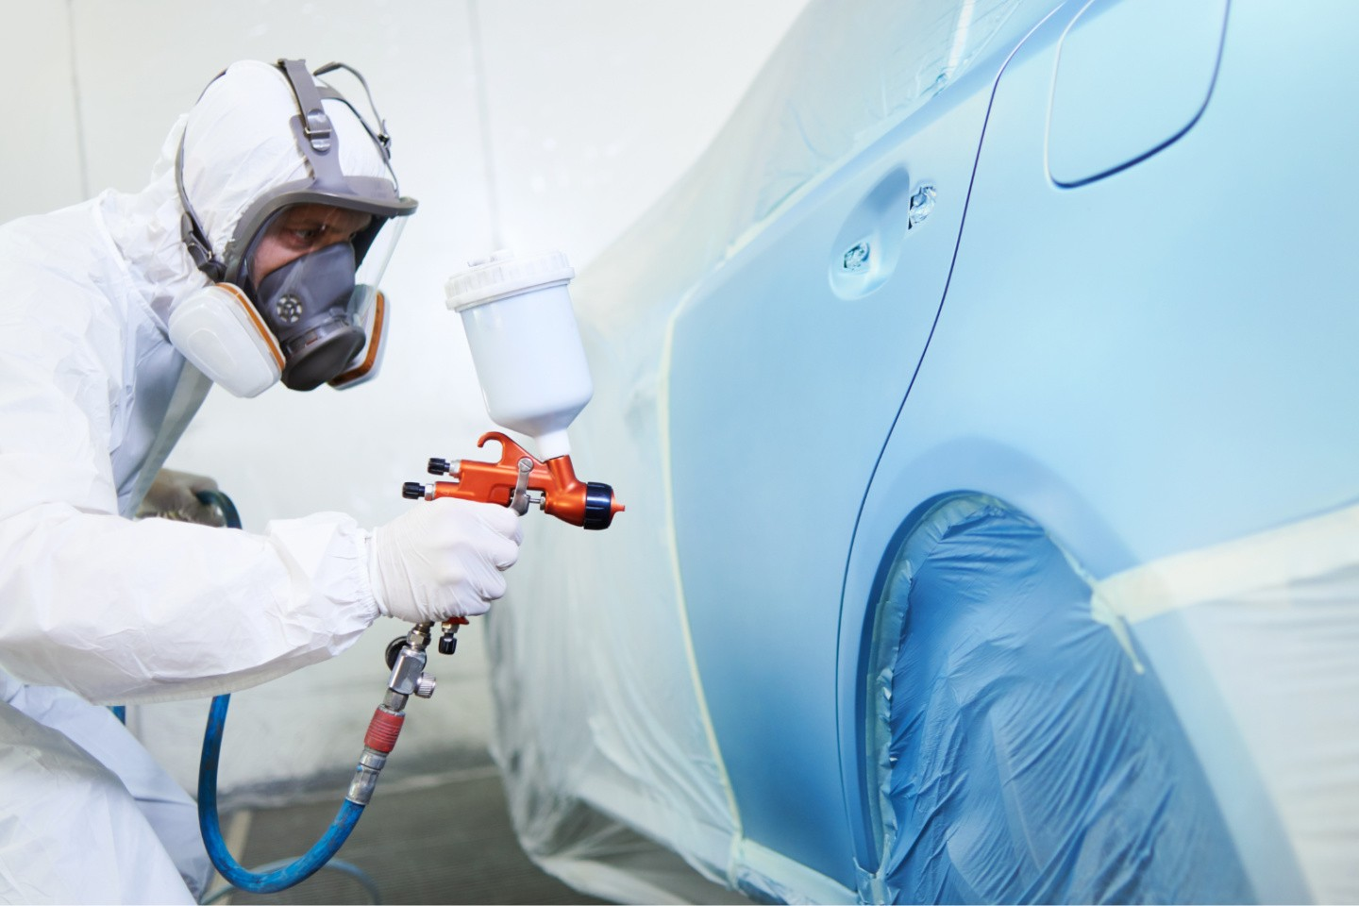
Refinish Car Paint:
Car paint refinishing involves restoring or repairing a vehicle's exterior coating. This can range from minor touch-ups to a full repaint, addressing issues like fading, scratches, or damage from accidents. The process generally involves cleaning, repairing imperfections, applying primer, and finally, the topcoat of paint.
صنایع رنگ مانگ
Putty/Primer
Layer of Refinish Car Paint:
Base-Coat
Top - Coat

Slide 5
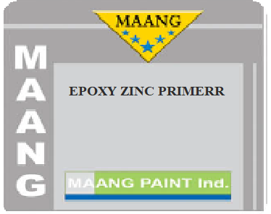
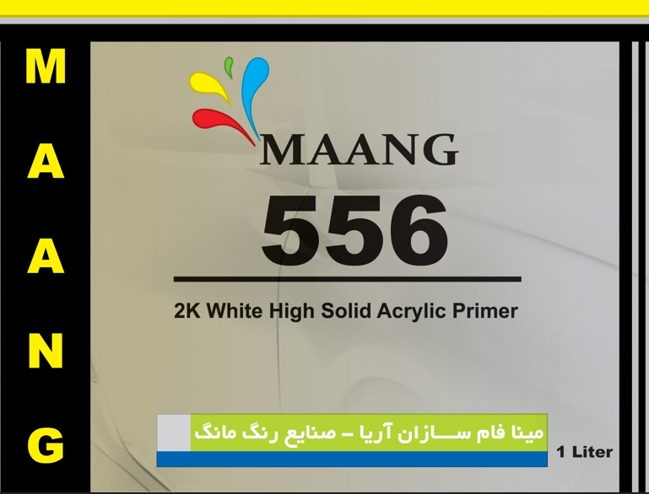
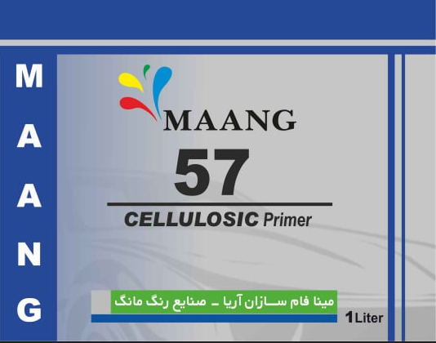
Refinish Car Paint:
1- Putty/Primer
صنایع رنگ مانگ
Automotive primers serve as a crucial base layer for car paint, enhancing adhesion and providing a smooth surface. Types include epoxy, urethane and nitrocellulose primers, each with unique properties for corrosion protection, filling imperfections, or promoting adhesion to bare metal. They also influence the final color's appearance and can improve the overall finish.
Epoxy Primer: Known for excellent corrosion resistance, epoxy primers are a good choice for protecting the car body from rust and moisture. They also offer strong adhesion to various surfaces like metal, plastic, fiberglass, and wood.
Primers
Urethane Primer : This two-part primer is often used for filling in minor imperfections and scratches before painting. It's commonly used alongside putty or fillers for repairs and provides good sanding properties.
Nitrocellulose Primer: NC primer is a fast-drying primer used in automotive refinishing and other applications. It's known for its ability to provide a smooth, even base for topcoats, while also offering good filling properties for minor surface imperfections. Nitrocellulose primers are compatible with both nitrocellulose (1K) and 2K topcoats, making them versatile for various painting projects

Slide 6
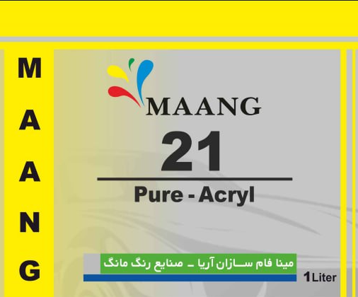
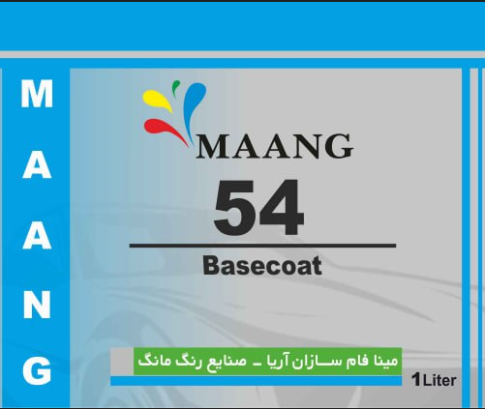
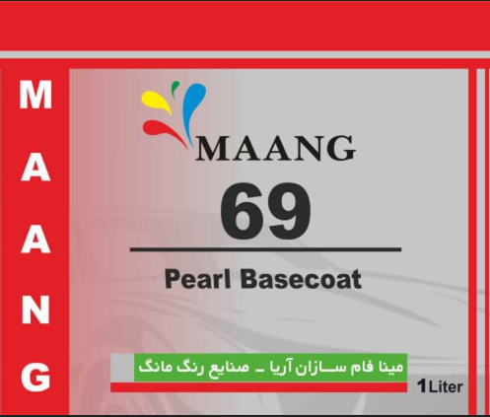
Refinish Car Paint:
2- Basecoat
صنایع رنگ مانگ
Car basecoat paint is the layer of paint that provides the primary color to a vehicle. It's applied after the primer and before the clear coat, and it's responsible for the visual appearance of the car's color. Basecoat paints come in various finishes, including solid, metallic, and pearlescent options.
Alkyd Paint
Nitrocellulose Paint
Basecoat
2K PU Solid Paint
Metallic Basecoat Paint
Pearlescent Basecoat Paint

Slide 7
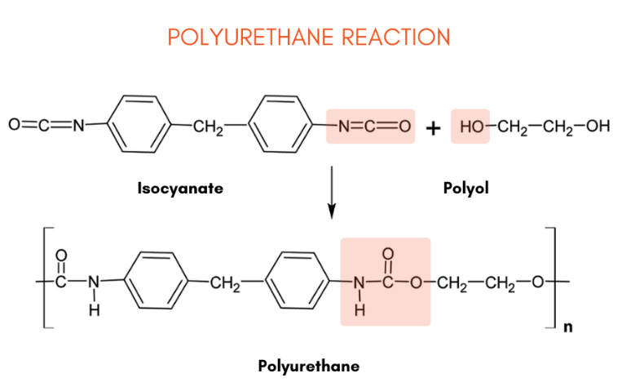
Refinish Car Paint:
2-1- Nitrocellulose and Alkyd Paint
صنایع رنگ مانگ
Nitrocellulose paint offers quick drying and easy repair, making it suitable for certain applications like automotive and wood paint. However, it's prone to yellowing, sunlight damage, and is highly flammable. Its high V.O.C content also necessitates good ventilation during application.
2-2- Polyurethane Paint (Solid Paint)
Durability
To start, urethane is highly durable and resistant to scratches, chipping, and fading. This makes it an ideal choice for cars that are frequently driven and exposed to the elements.
Color Retention
Along those lines, urethane paint is also known for its excellent color retention. This means that the color of your car will stay vibrant and bright for years to come. At paints for cars , our urethane paints provide UV resistance to maintain the colors for the best long-lasting results!
Versatility
It’s also worth noting that urethane car paint is very versatile. This means that urethane paint can be used on a variety of surfaces, including metal, plastic, and fiberglass. As a result, urethane is an excellent choice for painting cars with a variety of materials.
High Gloss Finish
Urethane paint produces a high gloss finish that looks fantastic on cars, giving them a sleek and polished appearance.

Slide 8
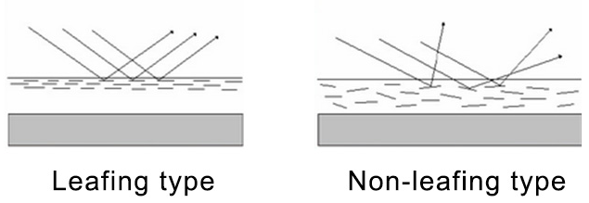
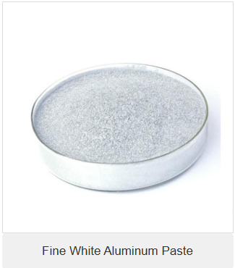
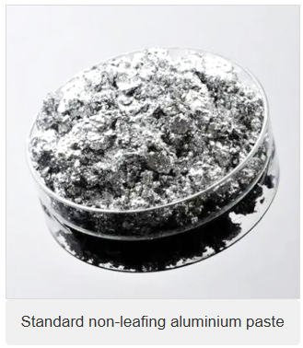
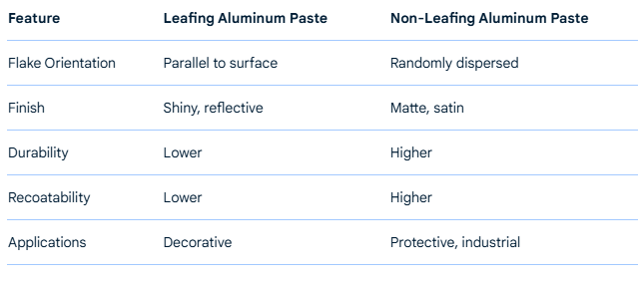
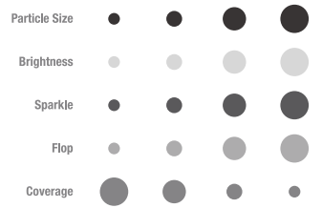
Refinish Car Paint:
2-3- Metallic Basecoat Paint
صنایع رنگ مانگ
Metallic basecoat paint is a type of automotive paint that contains tiny, reflective metal flakes giving it a shimmering, sparkling appearance. It's typically used as the color coat in a multi-stage paint system, requiring a clear coat to be applied on top for protection and a glossy finish.

Slide 9
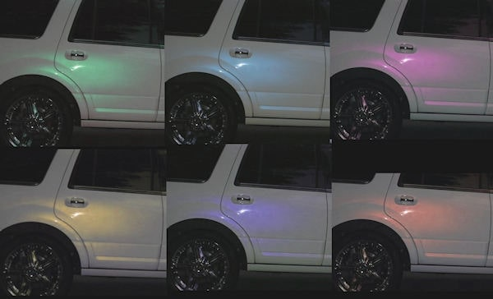
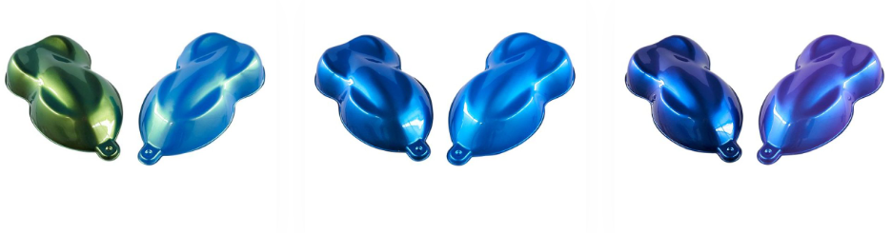
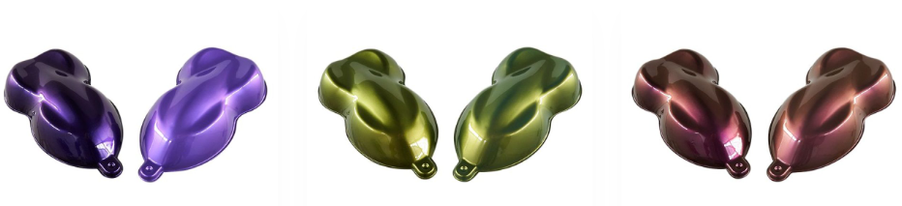
Refinish Car Paint:
2-4- Pearlescent Basecoat Paint
صنایع رنگ مانگ
Pearlescent basecoat paint is a type of automotive paint that creates a shimmering, iridescent effect, often resembling the look of pearls or mother-of-pearl. It achieves this by incorporating tiny, light-reflecting particles, such as mica flakes, into the paint, which scatter and reflect light in a way that produces a subtle color shift depending on the viewing angle. This effect is distinct from metallic paint, which uses metal flakes to achieve a different kind of sparkle.

Slide 10
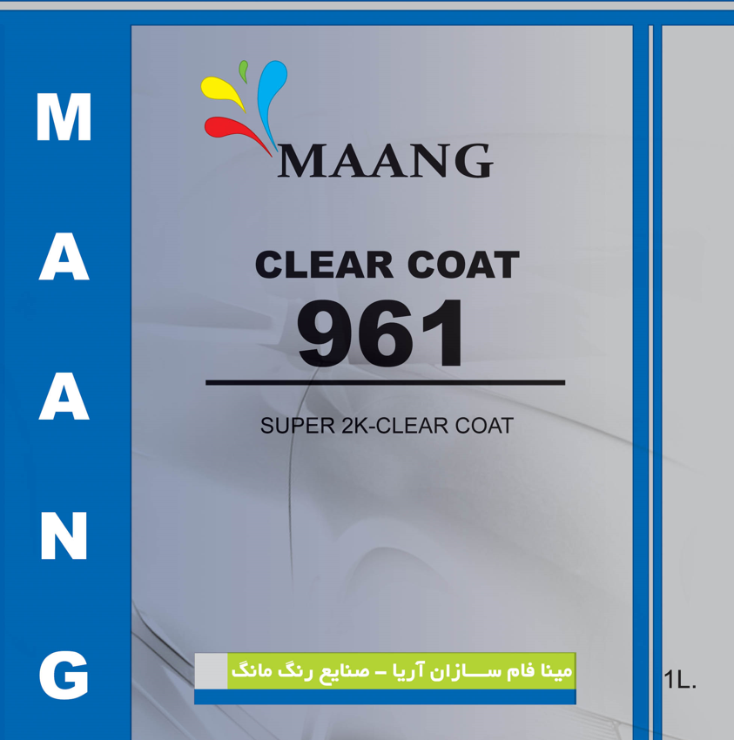
Refinish Car Paint:
3- Polyurethane Clear Coat
صنایع رنگ مانگ
Polyurethane clear coat for cars is a transparent protective layer applied over a car's paint job to enhance its appearance and durability. It's essentially a type of paint that provides a glossy finish and protects the underlying color coat from scratches, chips, UV damage, and environmental elements
Key Properties:
Durability:
Polyurethane clear coats are known for their exceptional durability, resisting scratches, chips, and fading.
Gloss:
They provide a high-gloss finish that enhances the appearance of the car's paint job, giving it a sleek and polished look.
UV Protection:
Polyurethane clear coats often include UV absorbers and anti-free radical technologies to prevent the underlying paint from fading or degrading due to sun exposure.
Chemical Resistance:
They offer protection against various chemicals, including bird droppings, tree sap, and road salt, preventing damage to the paint.
Weather Resistance:
Polyurethane clear coats can withstand extreme weather conditions, including rain, snow, and temperature fluctuations, without losing their protective properties.
Versatility:
They can be applied to various surfaces, including bare metal, painted surfaces, and even some plastics, according to Car-Rep.

Slide 11
صنایع رنگ مانگ
تولیدکننده انواع رنگهای تعمیراتی اتومبیلی، صنعتی و دکوراتیو
Thanks For Your Attention

